Slide 1
How to Write Code Better and Faster: An Introduction to Using Integrated Environments in Your Daily Workflow
Daniel Perrefort
University of Pittsburgh

Slide 2


Slide 3
What is an IDE?
An Integrated Development Environment (IDE) is a software application designed to maximize a programmer’s productivity by providing comprehensive set of tools and facilities. - Wikipedia

Slide 4
Are Jupyter Notebooks an IDE?
Yes... kind of....
Autocomplete
Syntax highlighting
Code execution
Cross language support (HTML, Markdown)
But no, not really....
No cross file support
No integrated test suite / profiling tools
No refactoring or code search tools
Missing dozens of other useful features

Slide 5
Common IDE Features
Refactoring
Real time syntax and argument checking
Automatic code formatting
Automatic docstring templates
Code navigation
GitHub Integration
Test suite integration
Test coverage reports
Profiling
All of your tools in one place (Terminal, File Explorer, Code Editor, GitHub UI, ...)
Optimization Suggestions
Built-in debugging tools
Auto code generation (getters and setters)
File navigation
Command line interface
PEP-8 integration
Over 77% of Developers use an IDE!
- Jetbrains SDER 2017

Slide 6

Don’t be turned away by “professional” features!
(By the way: This is free for students!)

Slide 7
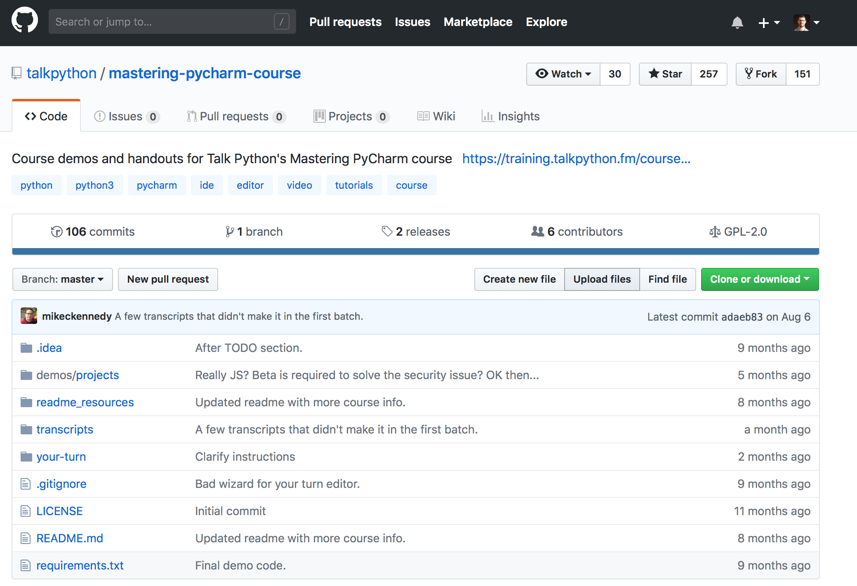

Slide 8
Visual Studio Code
Anjuta
PyCharm
Komodo IDE
MonoDevelop
Geany
KDevelop
NINJA-Compiler

Slide 9
Examples...

